Slide 1
New markets
Tatiana
Yuchen

Slide 2
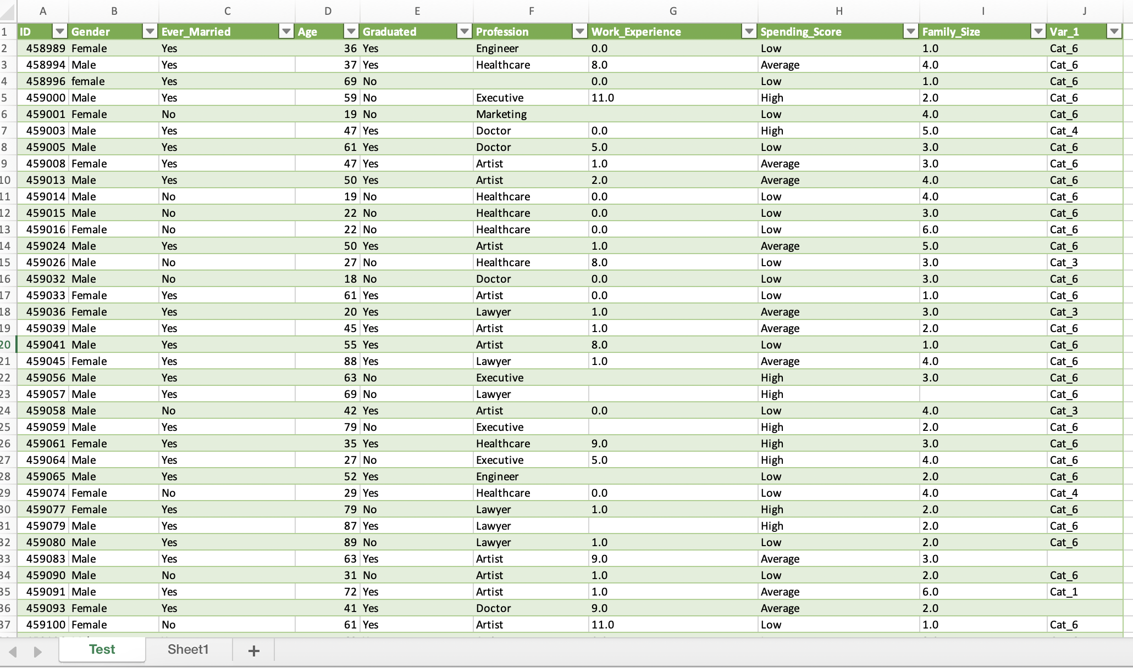
The Original Dataset
2627 rows
Variables : ID, Gender, Age, Ever_Married, Family size, Graduated, Profession, Work_Experience, Spending_Score, Var_1
Different data types : mostly categorical (nominal), not ordinal
Spending_Score: High (target group), Average, Low
A mystery variable : Var_1, with 7 categories.
Notes:
Yuchen

Slide 3
Process
Setting up Github – using the readme file to follow progress (but no Jira)
Defining our goal : who are the high spending costumers the company should focus on ?
Data cleaning…
Data cleaning (duplicates, outliers, odd data)
NA values and imputation – column by column approach
Highlights & challenges :
Drop work XP
Imputation for family size : mean (2.8) or median (2) ?
No forced imputation for profession (« unknown »)
& analyzing
Checking for correlations
The crosstab method (thanks Berkay 🥰)
Highlights & challenges :
New categorical variables for age (quartiles)
And for family size
Visualisation with Python vs. SQL
Should we explode everything ?

Slide 4
Results
An exploration table for the first key variables (gender, married, graduated)
High spending costumers (our new market) :
(have been) married, graduated, family size +2, older (age mean = 59, vs. 47 for average spenders and 38 for low spenders
Top spending professions : lawyers (31% vs. 8% in gen pop), executives (30% vs. 7%), and then artists (20% but >30% in gen pop) ! Note redundancy w/ graduation

Slide 5
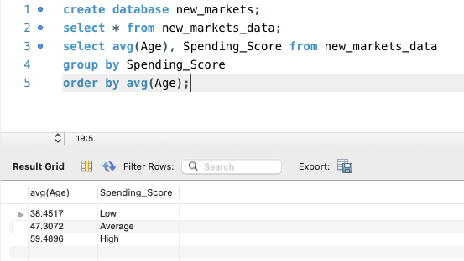
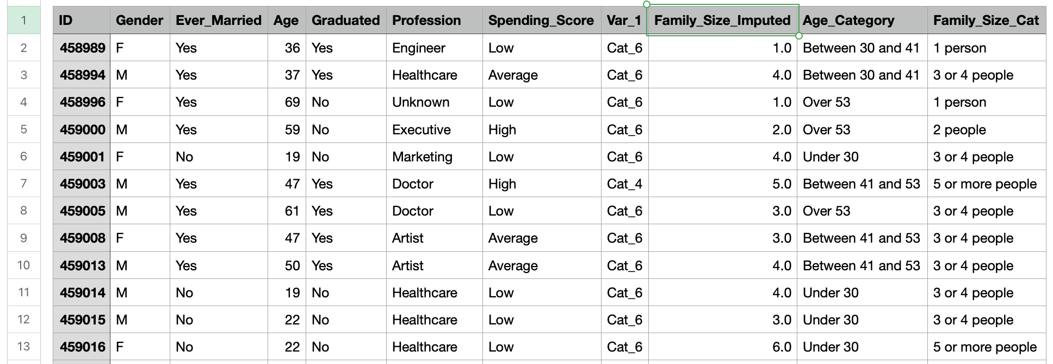
Results
Age difference – in MySQL !
A clean dataset that can be further analyzed

Slide 6
Two sociologists working together…
Expected decision making flowchart in Ironhack project
(source : https://www.lucidchart.com/pages/what-is-a-flowchart-tutorial)
Actual decision making flowchart in Ironhack project
(source Jon Worth's "Brexit - what next?" diagram - https://euroblog.jonworth.eu/)

